Slide 1

Exam AZ-801: Configuring Windows Server Hybrid Advanced Services Crash Course
Tim Warner
@TechTrainerTim

Slide 2


Tim Warner
Based in Nashville, TN, US
Central time zone
MCT, MVP
Twitter: @TechTrainerTim
Badge: TechTrainerTim.com

Slide 3
Day 1 of 2 Agenda
Introduction
Windows Server hybrid security
Windows Server high availability
Disaster Recovery (start)

Slide 4
Day 2 of 2 Agenda
Content catch-up
Disaster Recovery (finish)
Server and Workload Migration
Monitoring and Troubleshooting

Slide 5
Course Materials
timw.info/az801

Slide 6
Course Expectations
The Hybrid Administrator Associate badge is not an introductory certification
Please review the recordings…several times!
10-minute break at midpoint
I’m here to answer your questions – take advantage of this
Use the Q&A panel

Slide 7

Session Recordings

Slide 8

Session Recordings

Slide 9

Session Recordings

Slide 10


Mobile Browser: learning.oreilly.com

Slide 11



O'Reilly Mobile App

Slide 12

Microsoft Certification Tiers

Slide 13
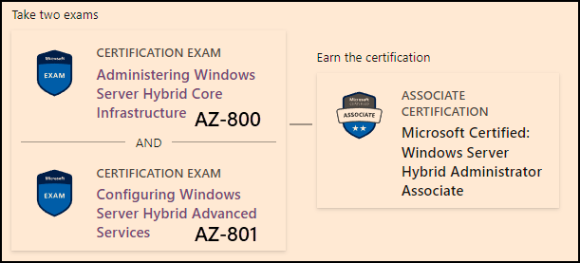
Windows Server Hybrid Admin Assoc.
1-year cert validity

Slide 14

Tim's Certification Study Model

Slide 15
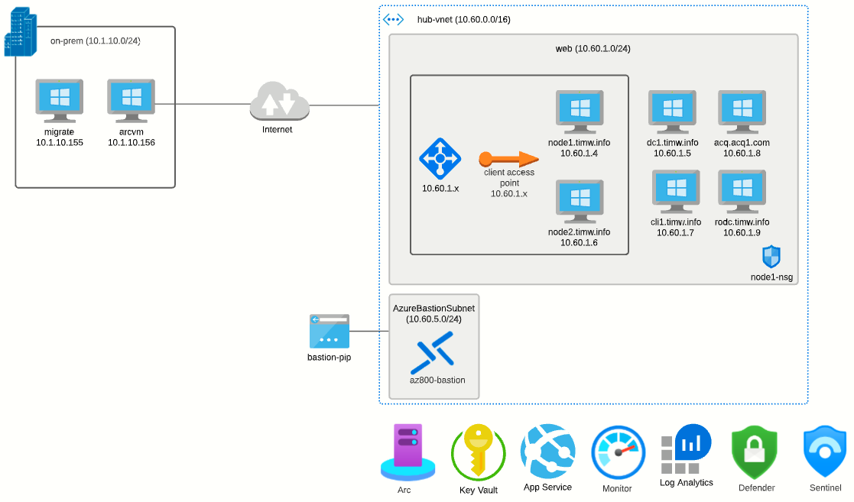
Class Topology

Slide 16
Thank you!
Course materials: timw.info/az801
Twitter: @TechTrainerTim
Work: timw.info/ps
Web: TechTrainerTim.com

Slide 17
Security

Slide 18
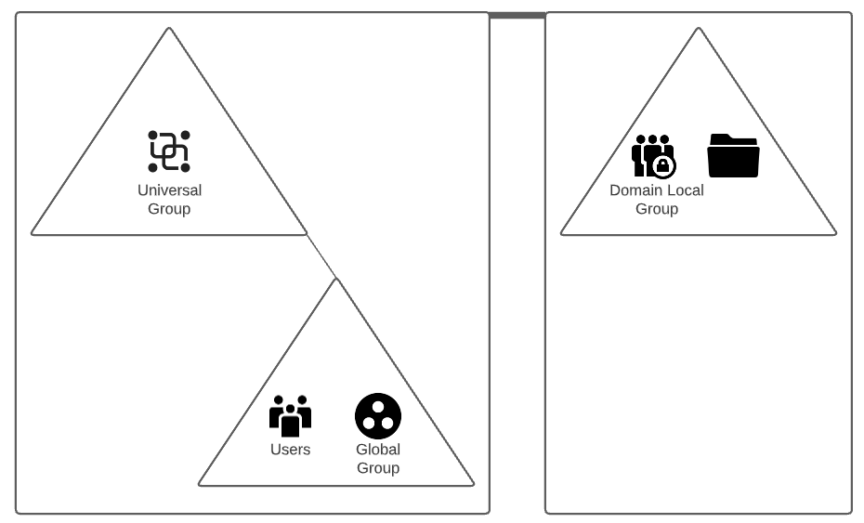

AD Group Security Best Practices

Slide 19
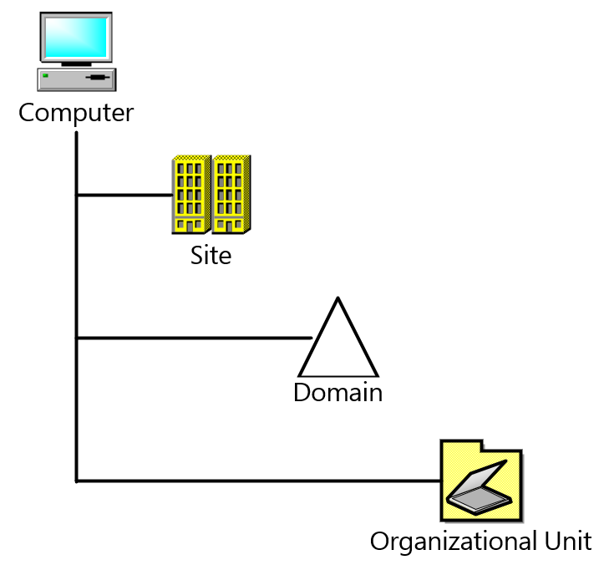
Group Policy Scope (L-S-D-OU)

Slide 20
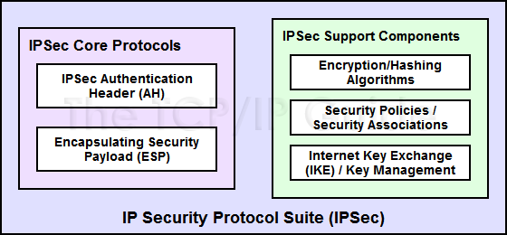
IPSec Components
Citation: timw.info/axu

Slide 21
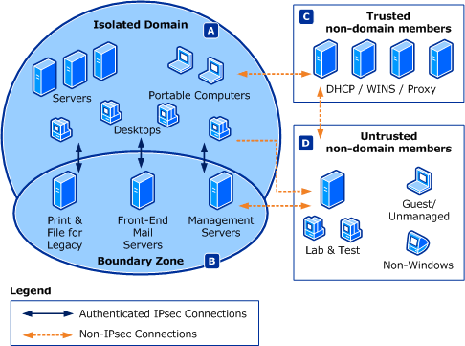
Connection Security Rules

Slide 22
High Availability

Slide 23
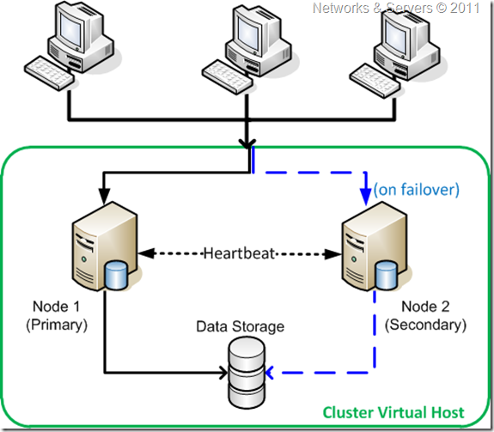
Failover Clustering
Ref: timw.info/ga6

Slide 24
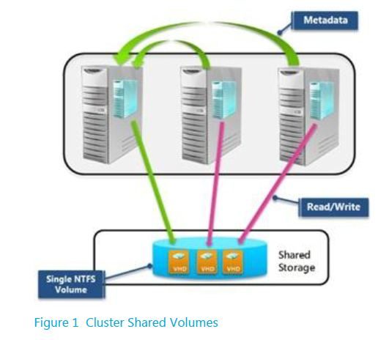
Cluster Shared Volumes (CSVs)
Ref: timw.info/ai4

Slide 25
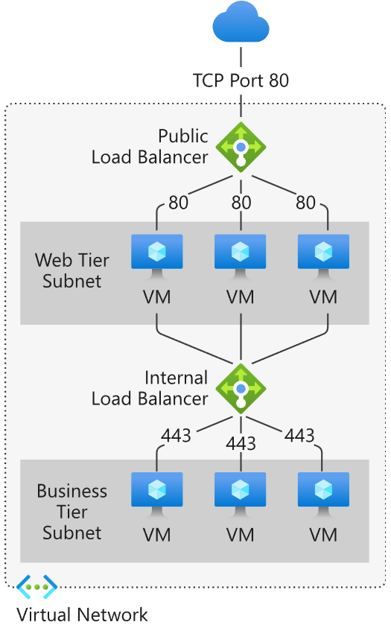
Azure Load Balancer
Ref: timw.info/0fx

Slide 26
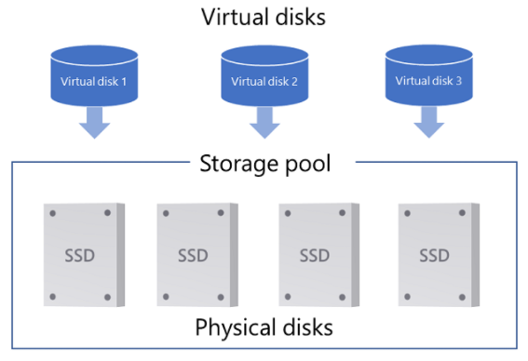
Storage Spaces Direct (S2D)
Ref: timw.info/mhx

Slide 27
Disaster Recovery

Slide 28

Azure Backup
Ref: timw.info/air

Slide 29

Azure Site Recovery

Slide 30
Migration

Slide 31
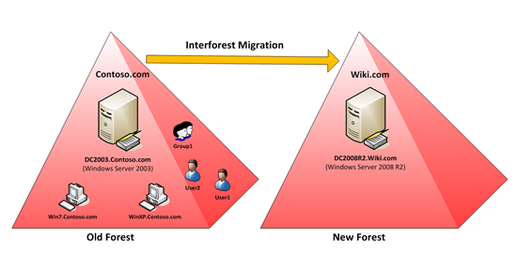
Active Directory Migration Tool (ADMT)
Ref: timw.info/in1

Slide 32
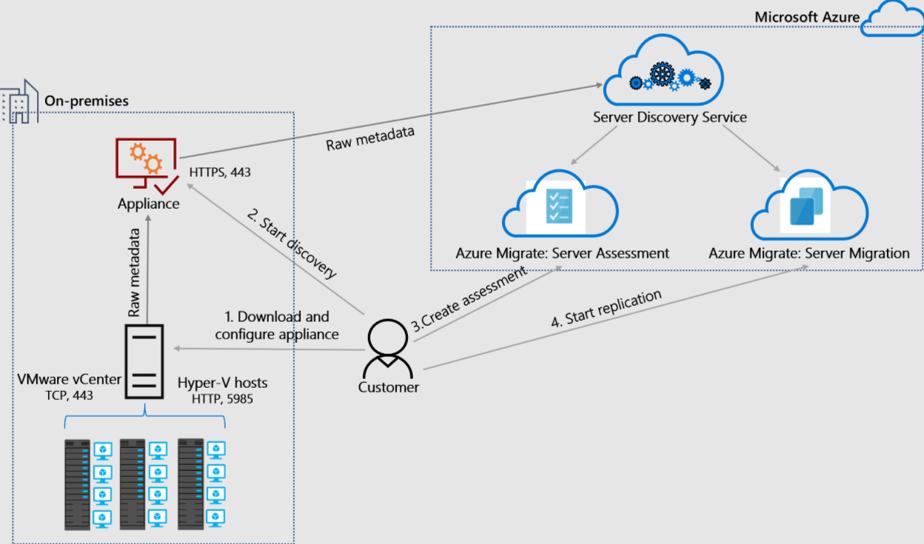
Azure Migrate Server Migration
Ref: timw.info/fng

Slide 33
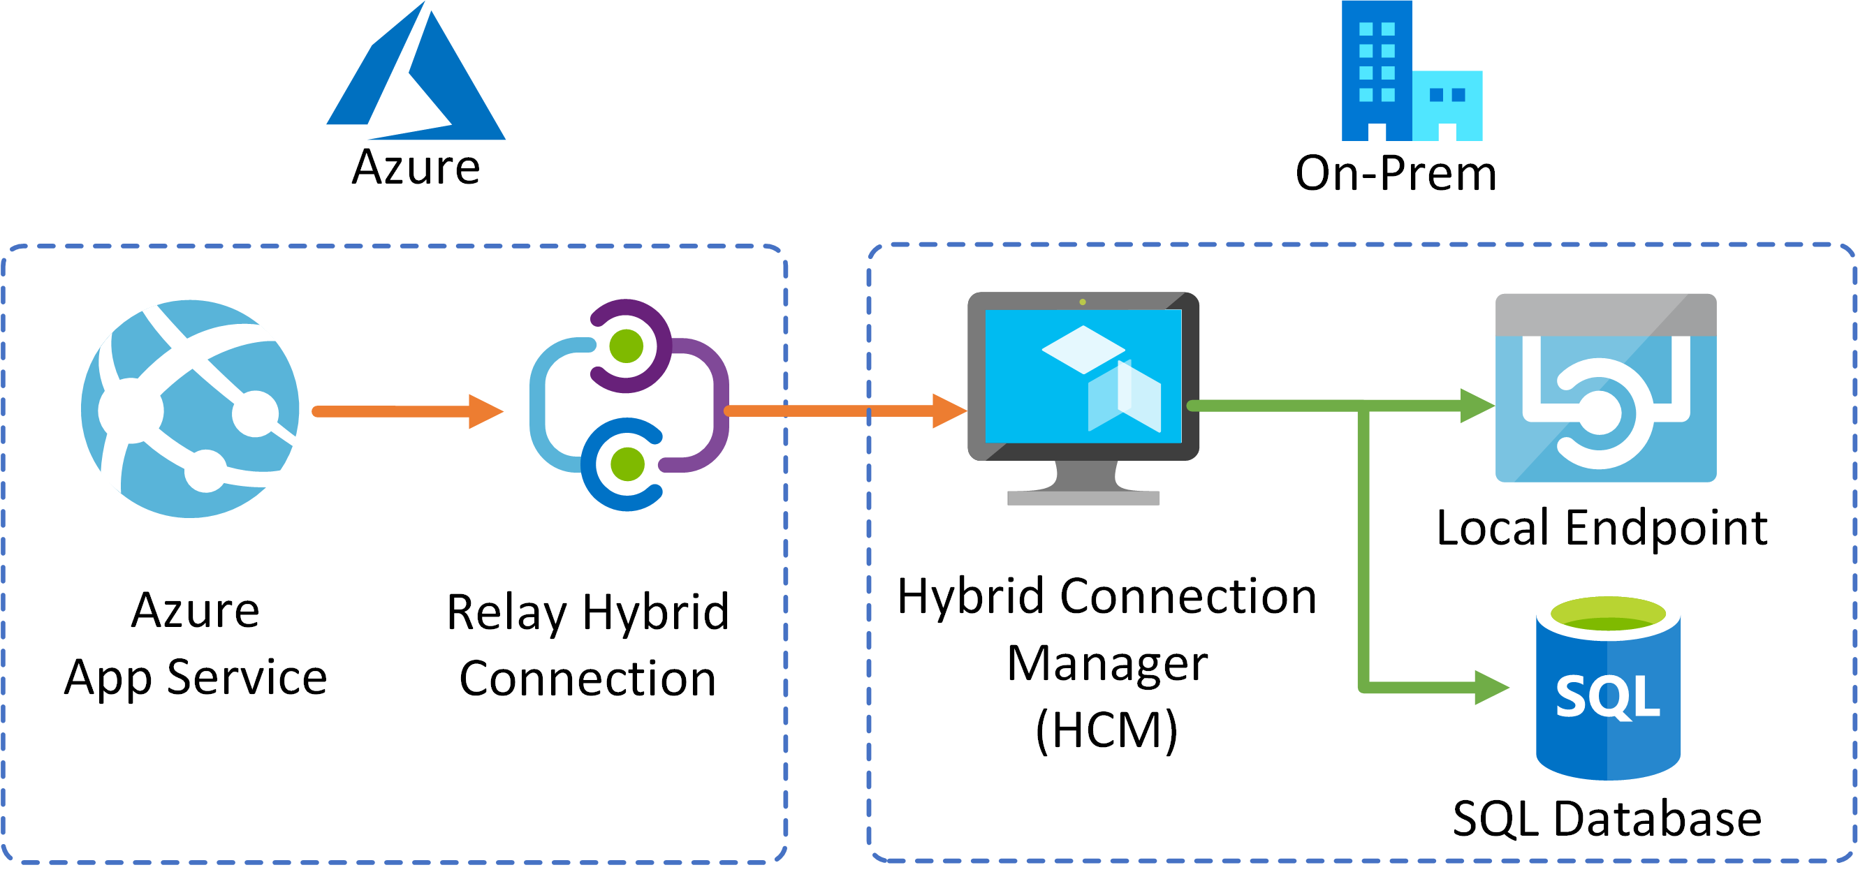
App Service Hybrid Connection
Ref: timw.info/pqk

Slide 34
Monitoring

Slide 35
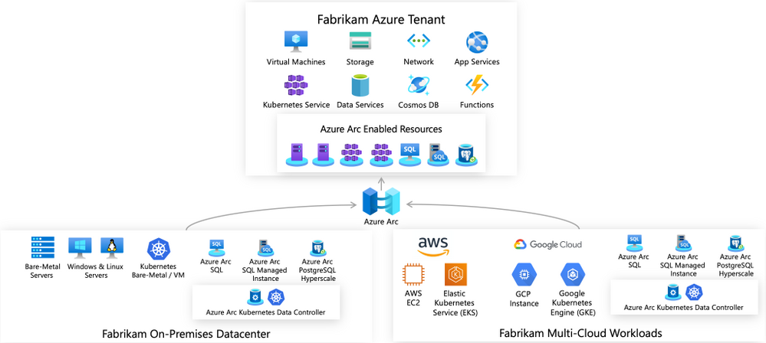
Azure Arc-Enabled Servers
Ref: timw.info/7sn

Slide 36
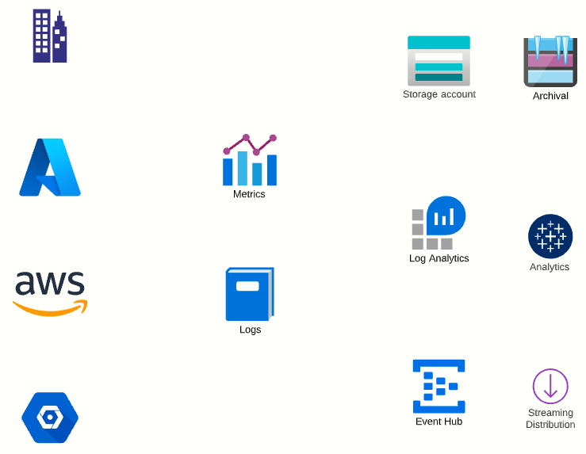
Diagnostics Settings

Slide 37
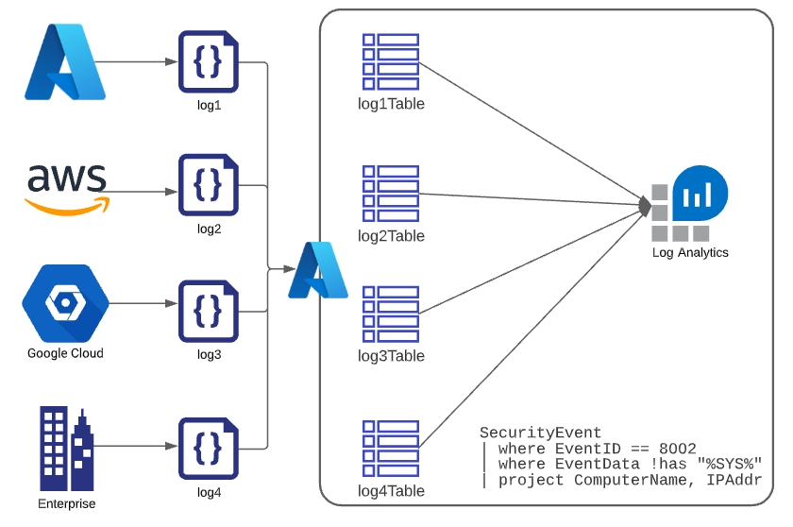
Azure Log Analytics

Slide 38
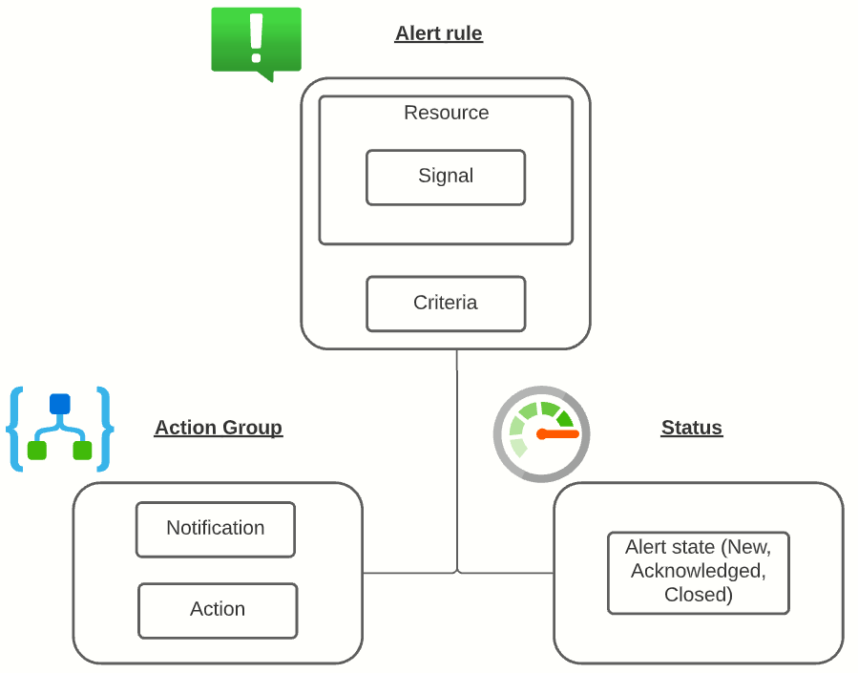
Azure Alert Logic

Slide 39
Exam Prep

Slide 40


Single-Answer Multiple Choice

Slide 41

Multiple Answer Multiple Choice

Slide 42
Repeated Scenario
You need to move an Azure VM to another hardware host.
Solution: You redeploy the VM.
Does this solution meet the goal?
Yes
No

Slide 43
Repeated Scenario
You need to move an Azure VM to another hardware host.
Solution: You create a proximity placement group.
Does this solution meet the goal?
Yes
No

Slide 44

Select and Place

Slide 45

Build List and Reorder

Slide 46
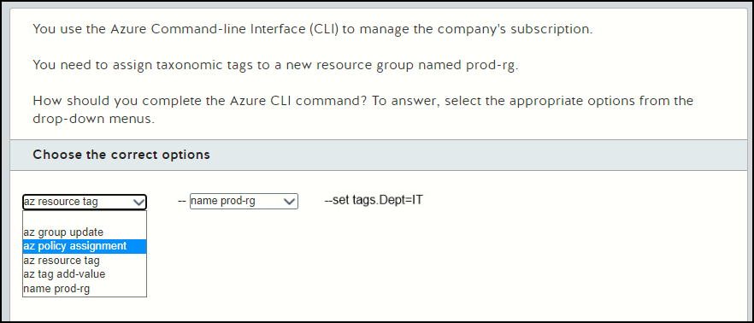
Active Screen

Slide 47

Case Study

Slide 48






Performance-Based Lab

Slide 49
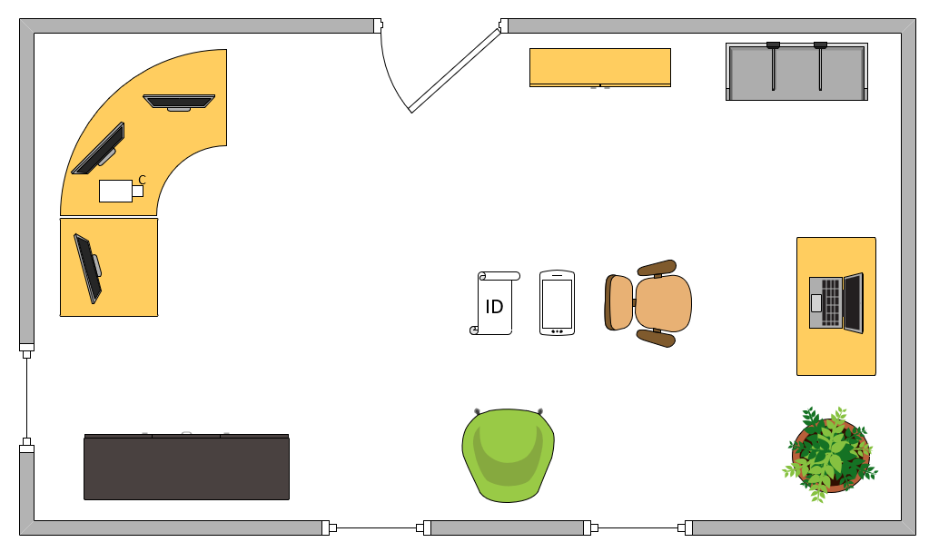
Ideal Testing Room

Slide 50
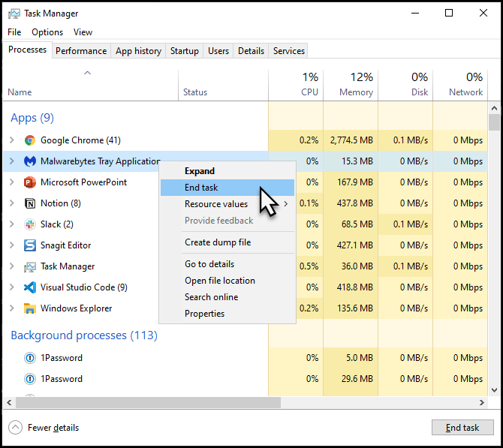
Kill Those Background Processes!
All foreground apps except OnVUE
Pause Windows Update
Stop antimalware (!)
Stop GameBar*

